Slide 1
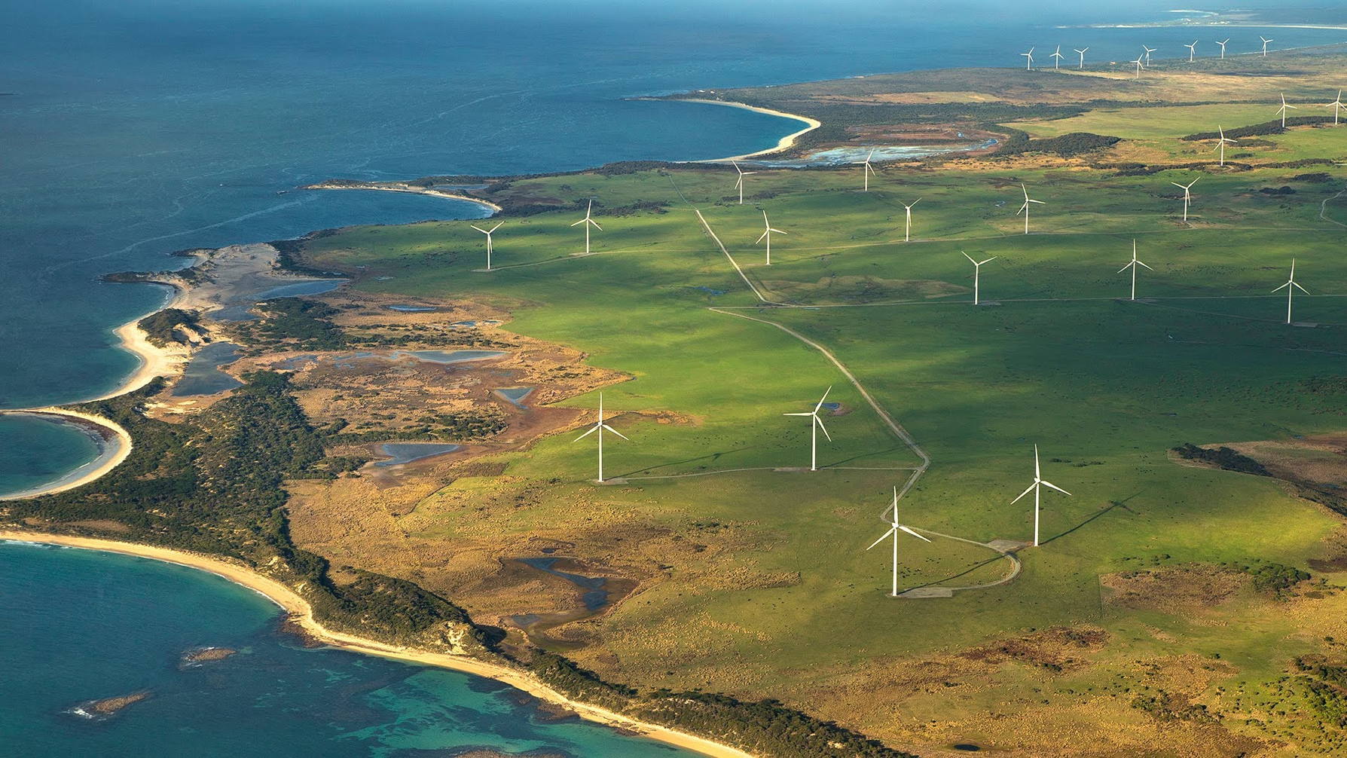
Best Practices for
Wake Model and Optimization Algorithm Selection
in Wind Farm Layout Optimization
Nicholas F. Baker , Andrew P. J. Stanley , Jared J. Thomas, and Andrew Ning
Brigham Young University, Provo, Utah 84602
Katherine Dykes
National Renewable Energy Laboratory, Golden, Colorado 80401
SciTech 2019

Slide 2
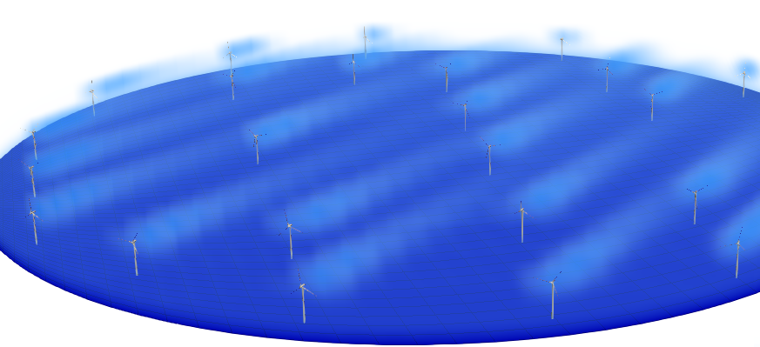
Notes:
WIFM:
Placement of turbines is important due to wake
SADS

Slide 3
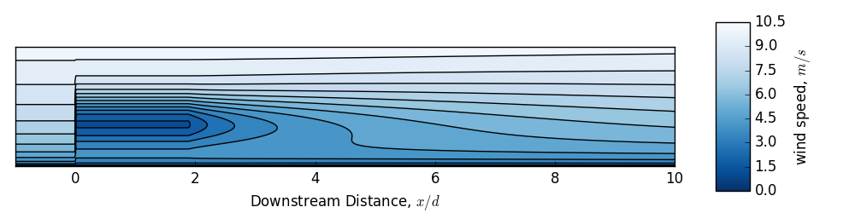
Notes:
Rotors in this waked area feel both:
1) Decrease wind velocity (so less power)
2) Increased stress (so shorter lifespan)

Slide 4
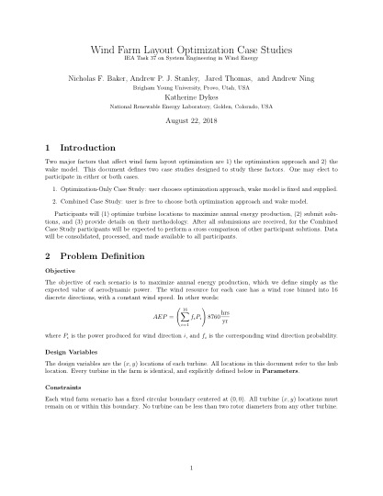
Notes:
We mde two case studies
We asked for participants, got 9

Slide 5
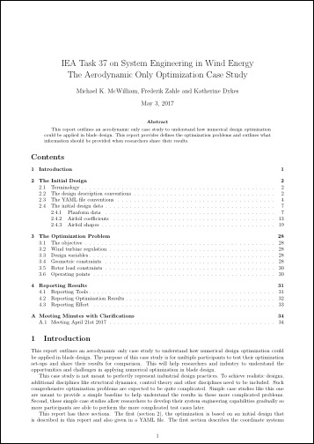
Notes:
We’er working off a past case, specific to turbines
Applying to a larger farm
Mike McWilliam

Slide 6
Designing the Case Studies

Slide 7
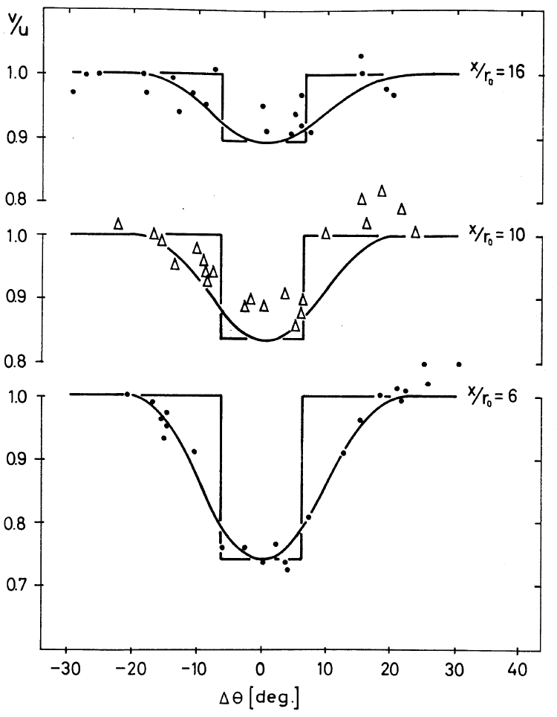
Designing the Case Studies
Wake Model

Slide 8
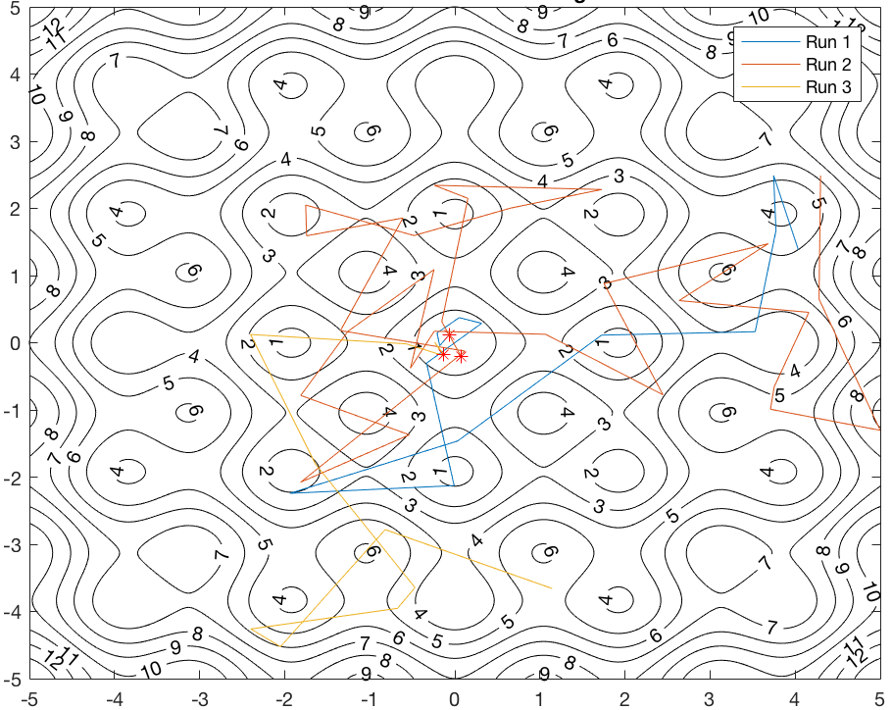
Two Variables to Isolate
Wake Model
Optimization Method

Slide 9
Wind Farm Scenario

Slide 10
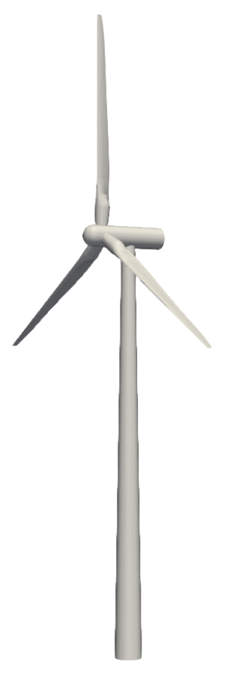
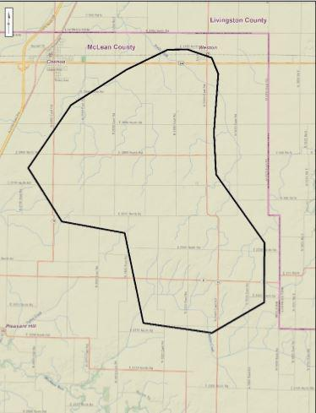
Wind Farm Scenario

Slide 11
Turbine:

Slide 12
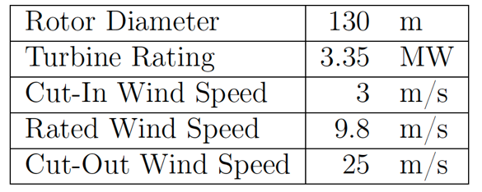
Turbine: IEA’s 3.35 MW reference

Slide 13
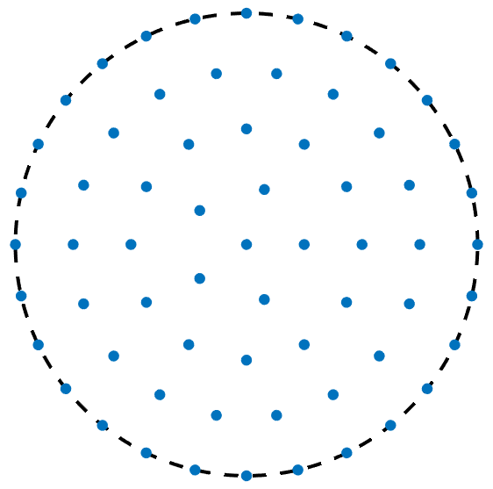
Boundary: Circular

Slide 14
Wind Rose: Bimodal, off-axis

Slide 15
Case Study 1

Slide 16
Case Study 1
Optimization Only (same design space)
Notes:
We used perfect squares to permit grid formations
Sizes roughly double in size to test for scalability of design variables

Slide 17
Case Study 1
Optimization Only (same design space)
Bastankhah’s Gaussian Wake Model
Notes:
We used perfect squares to permit grid formations
Sizes roughly double in size to test for scalability of design variables

Slide 18
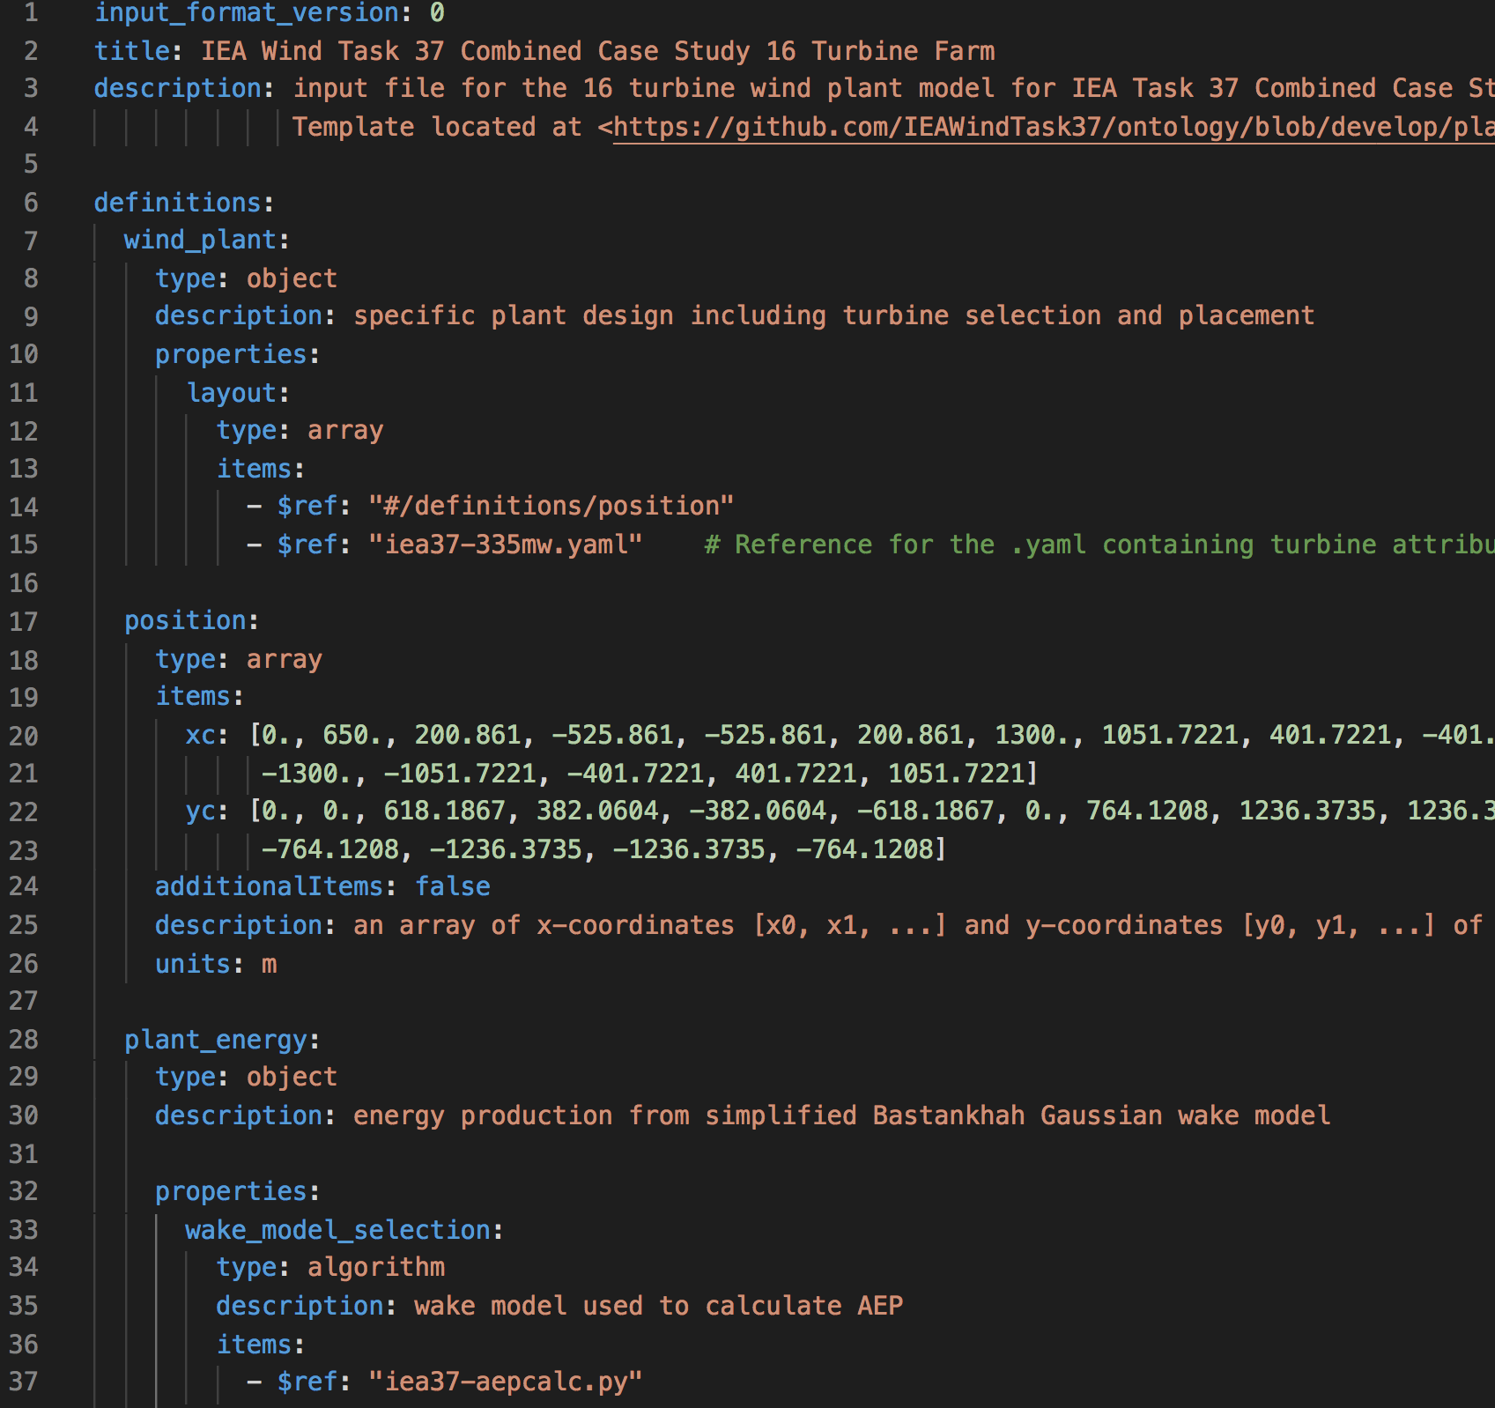
Case Study 1
Optimization Only (same design space)
Bastankhah’s Gaussian Wake Model
.yaml input files, reader supplied
Notes:
We used perfect squares to permit grid formations
Sizes roughly double in size to test for scalability of design variables

Slide 19
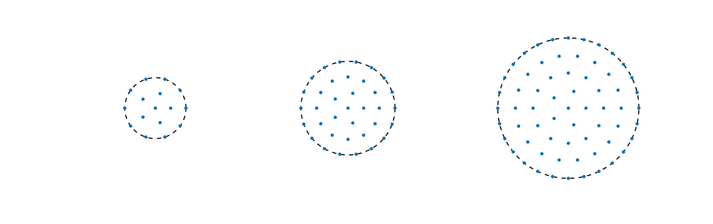
Case Study 1
Optimization Only (same design space)
Bastankhah’s Gaussian Wake Model
.yaml input files, reader supplied
3 wind farm sizes:
Notes:
We used perfect squares to permit grid formations
Sizes roughly double in size to test for scalability of design variables

Slide 20
Case Study 2
Notes:
Here we want to explore differences in wake models

Slide 21
Case Study 2
Combined Optimization and Wake Model (different design space)
+
Notes:
But certain models preclude certain optimization methods,
so we had to let the participants pick both.

Slide 22
Case Study 2
Combined Optimization and Wake Model (different design space)
Cross-comparison for results
Notes:
We didn’t have enough time to conduct an LES
Our analysis came from a cross-comparison of participant results through their individual models

Slide 23
Case Study 2
Combined Optimization and Wake Model (different design space)
Cross-comparison for results
One farm size:
Notes:
We didn’t have enough time to conduct an LES
Our analysis came from a cross-comparison of participant results through their individual models

Slide 24
Participants

Slide 25
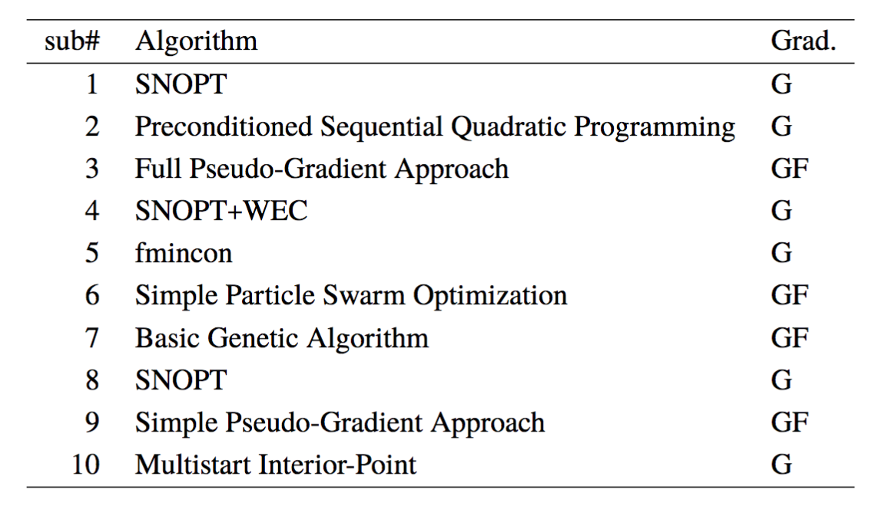
Participants
Notes:
Trends:
#2 incresed every time
#5 decreased every time
#1 kept getting best
Everyone improved on the provided example layout

Slide 26
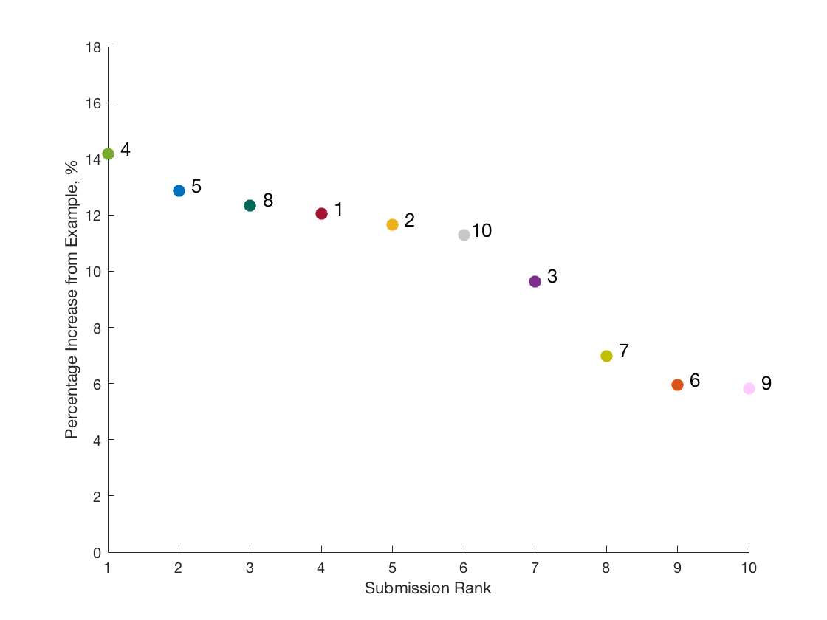
Results (cs1)
16 Turbine Case
Notes:
Trends:
#2 incresed every time
#5 decreased every time
#4 kept getting best
Everyone improved on the provided example layout

Slide 27
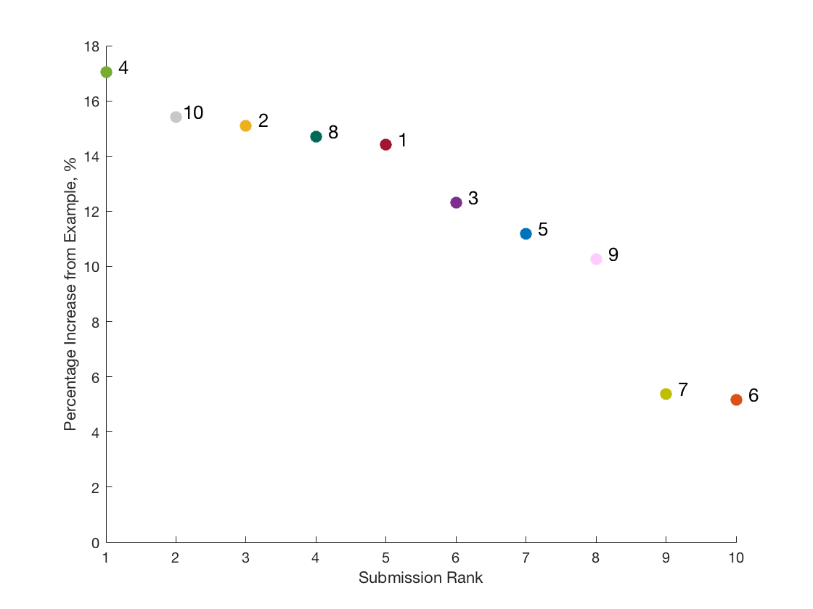
Results (cs1)
36 Turbine Case
Notes:
Trends:
#2 incresed every time
#5 decreased every time
#4 kept getting best
Everyone improved on the provided example layout

Slide 28
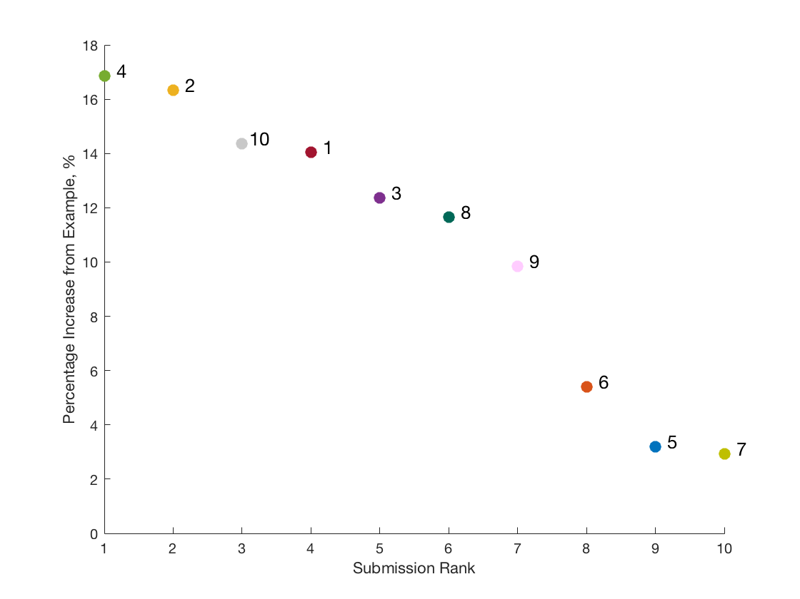
Results (cs1)
64 Turbine Case
Notes:
Trends:
#2 incresed every time
#5 decreased every time
#4 kept getting best
Everyone improved on the provided example layout

Slide 29
Results (cs1)
16 Turbine Case
36 Turbine Case
64 Turbine Case
Notes:
Trends:
#2 incresed every time
#5 decreased every time
#4 kept getting best
Everyone improved on the provided example layout

Slide 30
Results (cs1)
16 Turbine Case
36 Turbine Case
64 Turbine Case
Notes:
Trends:
#2 incresed every time
#5 decreased every time
#4 kept getting best
Everyone improved on the provided example layout

Slide 31
Results (cs1)
(16 Turbine Case)
Notes:
Trend to notice here is that there is no general pattern – each had a different approach.
- sub4 was the best. Arrayed some on the outside, and then a row perpendicular to the wind rose
- sub2 used a rotational method to find superior result
- sub

Slide 32
Results (cs1)
(64 Turbine Case)
Notes:
Trend to notice here is that there is no general pattern – each had a different approach.
- sub4 was the best. Arrayed some on the outside, and then a row perpendicular to the wind rose
- sub2 used a rotational method to find superior result
- sub

Slide 33
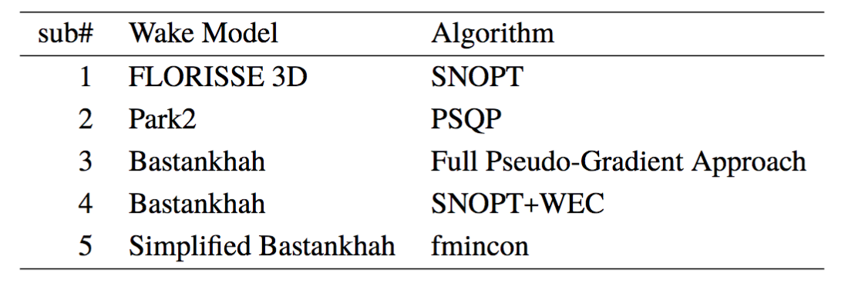
Participants
Notes:
Can’t compare because of wake model

Slide 34
Results (cs2)
Notes:
Interesting thing to notice here is that 1, 2, and 3 didn’t find their own placement as the best.
Means that there were optima with their model that their optimization method didn’t find – could be time, could be algorithm, could be pairing of algorithm with model.

Slide 35
Results (cs2)
Participant
Cross-Comp
sub1
sub2
sub3
sub4
sub5
sub4
sub4
sub5
sub4
sub5
Notes:
Interesting thing to notice here is that 1, 2, and 3 didn’t find their own placement as the best.
Means that there were optima with their model that their optimization method didn’t find – could be time, could be algorithm, could be pairing of algorithm with model.

Slide 36
Results (cs2)
Notes:
Interesting thing to notice here is that 1, 2, and 3 didn’t find their own placement as the best.
Means that there were optima with their model that their optimization method didn’t find – could be time, could be algorithm, could be pairing of algorithm with model.

Slide 37
Time comparison
Notes:
Of note, the top 3 submissions (#4, #2, and #10)
- All 3 used gradient-based methods
- Order of magnitudes on time are different
- Comparing 4 to 10, use of these methods is a time-tradeoff. In the 64 turbine case, sub4 found a superior result, but took about 4 times longer.
- The tradeoff in use would be time vs power – if you need a quick solution with

Slide 38
Takeaways
In these scenarios, gradient based methods were superior
Notes:
ToDo:
1) Note that you corrected the 36 turbine case table from paper (insert #6)
2) Note that you corrected cs2’s naming in the results table for subs 4 and 5.

Slide 39
Takeaways
In these scenarios, gradient based methods were superior
Intuitive rotation steps by sub2
Notes:
ToDo:
1) Note that you corrected the 36 turbine case table from paper (insert #6)
2) Note that you corrected cs2’s naming in the results table for subs 4 and 5.

Slide 40
Takeaways
In these scenarios, gradient based methods were superior
Intuitive rotation steps by sub2
Sampling done by sub4
Notes:
ToDo:
1) Note that you corrected the 36 turbine case table from paper (insert #6)
2) Note that you corrected cs2’s naming in the results table for subs 4 and 5.

Slide 41
Takeaways
In these scenarios, gradient based methods were superior
Intuitive rotation steps by sub2
Sampling done by sub4
Optimizing the provided code, other languages
Notes:
ToDo:
1) Note that you corrected the 36 turbine case table from paper (insert #6)
2) Note that you corrected cs2’s naming in the results table for subs 4 and 5.

Slide 42
Future Work
Larger farm sizes for sub2’s trend
Clearer requirements for time measurement
More participants for next round
Notes:
ToDo:
1) Note that you corrected the 36 turbine case table from paper (insert #6)
2) Note that you corrected cs2’s naming in the results table for subs 4 and 5.

Slide 43

﻿Comparing of Wind Farm Layout Optimization Results Using a Simple Wake Model and Gradient-Based Optimization to Large-Eddy Simulations
Nicholas F. Baker
Andrew PJ Stanley
Jared J. Thomas
Andrew Ning
Brigham Young University
Katherine Dykes
National Renewable Energy Laboratory
https://flow.byu.edu
Notes:
TODO: design this slide
The point?
LES predicted 9.9% improvement in AEP
Outline
The point and so what ($?)
Research questions
Start and end layouts
Change
AEP % (LES)
AEP GWh (LES)
Revenue (LES)
Outline
LES - precursor - NREL 5-MW
Test case
Base Layout and wind rose
Optimization
Objective function
Modeling
AEP
Wind turbine power
Farm model
Wake combination
Turbulence intensity
Local TI intro
3 approaches intro
Hard max
Smooth max and error
Sampling
Wake model
Original
Changes
X_d
shear
Images of cross-section
Verification
Horns rev intro + Vestas V80
Row averaged verification
Directional verification
Review test case
Results
Results distribution – remind of sampling
Final layout
Comparison
Comparison
Base Turbine error - image
Base Directional error - image
Base AEP error - image
Opt Turbine error - image
Opt Directional error
Opt AEP error
Why the improved accuracy at higher levels? Statistics review and comparison to mean (make sure this is applicable)
Show both directional power graphs
AEP improvement
Contact info slide

